Slide 1
PHASE 2 · WEEK 5 · REGRESSION & CLUSTERING
Linear & Logistic Regression
Theory · Mathematical Derivations · Loss Functions · Optimization
Includes:
Slide Deck • Jupyter Notebook • Study Guide
From first principles to production-ready models

Slide 2
ROADMAP
What we'll cover
01
Linear Regression
Model, probabilistic foundations, cost function, normal equation & gradient descent derivations
02
Optimization & Regularization
Gradient descent variants, learning rate, Ridge (L2) and Lasso (L1)
03
Logistic Regression
Sigmoid, MLE, cross-entropy derivation, gradients, convexity, softmax
04
Evaluation & Practice
Regression & classification metrics, a worked project tie-in
Linear & Logistic Regression
1

Slide 3
PART 1
Linear Regression
Predicting continuous outcomes — from a straight line to a full
probabilistic and optimization framework.

Slide 4
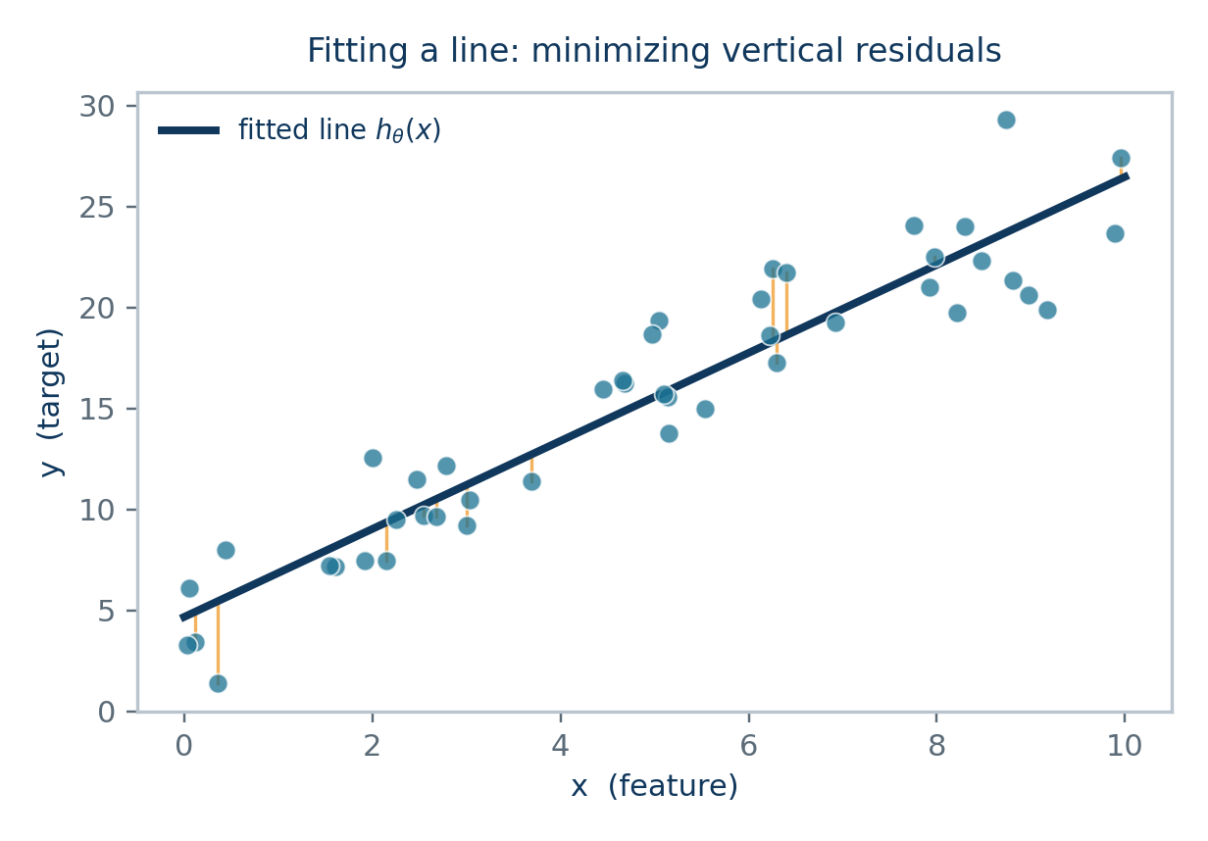
1.1 MODEL REPRESENTATION
The Linear Regression Hypothesis
Linear regression models the target y as a weighted sum of input features, plus a bias (intercept) term.
θ₀, θ₁, …, θₙ parameters (weights) learned from data
x₁, …, xₙ input features (independent variables)
θᵀx vectorized form — θ and x as column vectors, with x₀ = 1
Goal:
Find the parameter vector θ that makes h_θ(x⁽ⁱ⁾) as close as possible to the true y⁽ⁱ⁾ for every training example i.
Linear & Logistic Regression
2

Slide 5
1.2 MODEL DIAGNOSTICS
Assumptions of Linear Regression
1
Linearity
2
Independence
The relationship between features and target is linear in the parameters θ.
Observations (and residuals) are independent of one another.
3
Homoscedasticity
4
Normality of errors
Residuals have constant variance across all levels of the fitted value.
Residuals ε are normally distributed — this justifies using MSE (next slide).
5
No multicollinearity
6
No/limited outliers
Features aren't highly correlated with each other, so θ estimates stay stable.
Extreme points can disproportionately pull the least-squares fit.
Linear & Logistic Regression
3

Slide 6
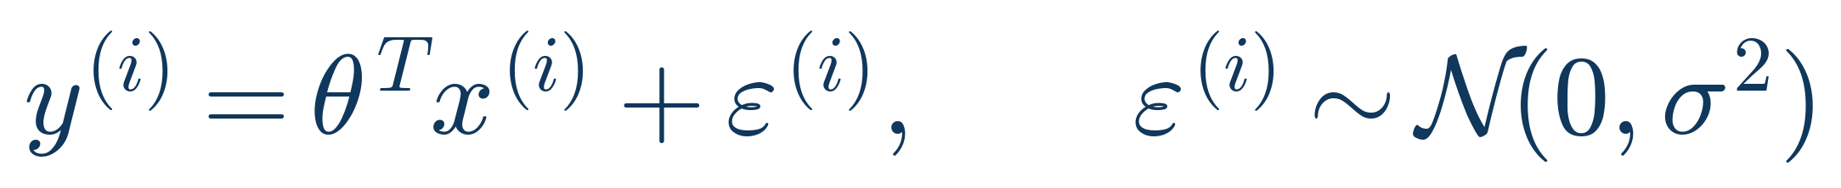
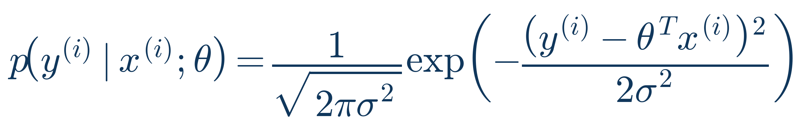
1.3 WHY SQUARED ERROR?
A Probabilistic View of Linear Regression
Assume each target is the true linear signal plus Gaussian noise:
This says y⁽ⁱ⁾, given x⁽ⁱ⁾, is normally distributed around the line θᵀx⁽ⁱ⁾:
Key insight
Under this Gaussian-noise assumption, finding θ that maximizes the likelihood of the observed data (Maximum Likelihood Estimation, MLE) turns out to be exactly equivalent to minimizing the sum of squared errors. This is why 'least squares' isn't an arbitrary choice — it falls directly out of assuming Gaussian noise.
Linear & Logistic Regression
4

Slide 7
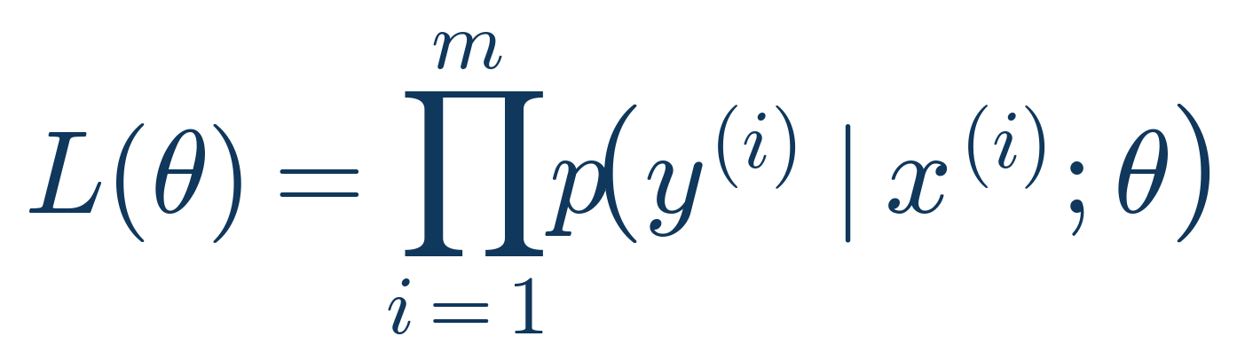
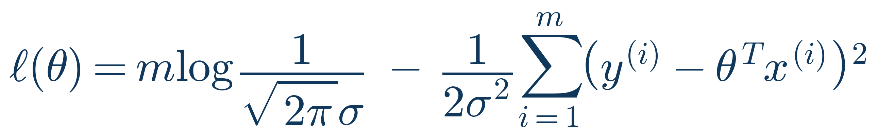
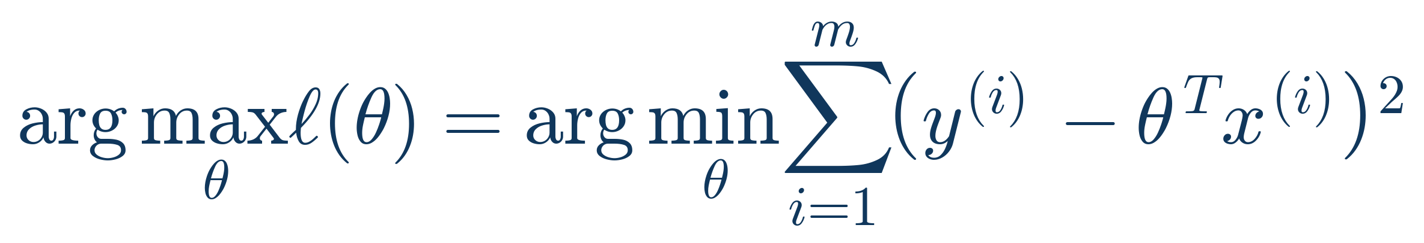
1.4 DERIVATION
From Maximum Likelihood to Mean Squared Error
Step 1 — Likelihood of the full dataset
Assuming i.i.d. samples, the joint likelihood is the product of individual densities.
Step 2 — Take the log-likelihood
Logs turn the product into a sum, which is far easier to differentiate. The first term doesn't depend on θ.
Step 3 — Maximizing ℓ(θ) ⇔ minimizing squared error
Since the first term is constant in θ and σ² > 0, maximizing ℓ(θ) is equivalent to minimizing the sum of squared residuals.
Linear & Logistic Regression
5

Slide 8
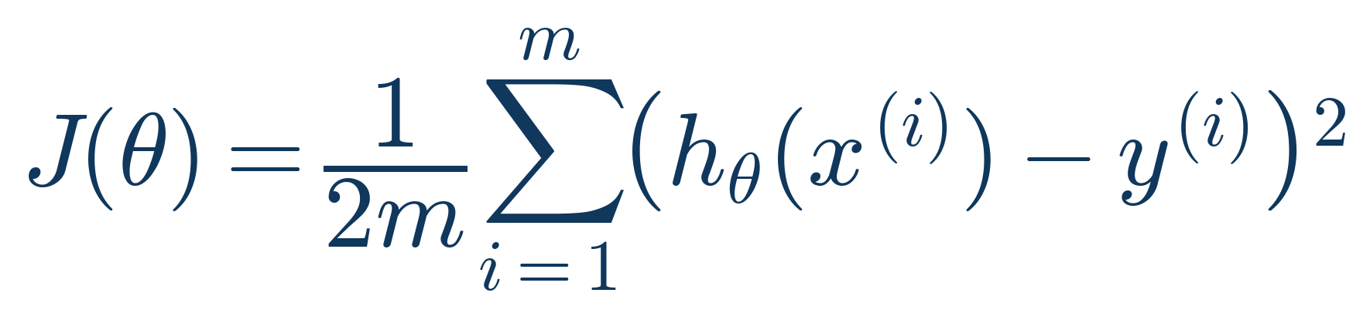
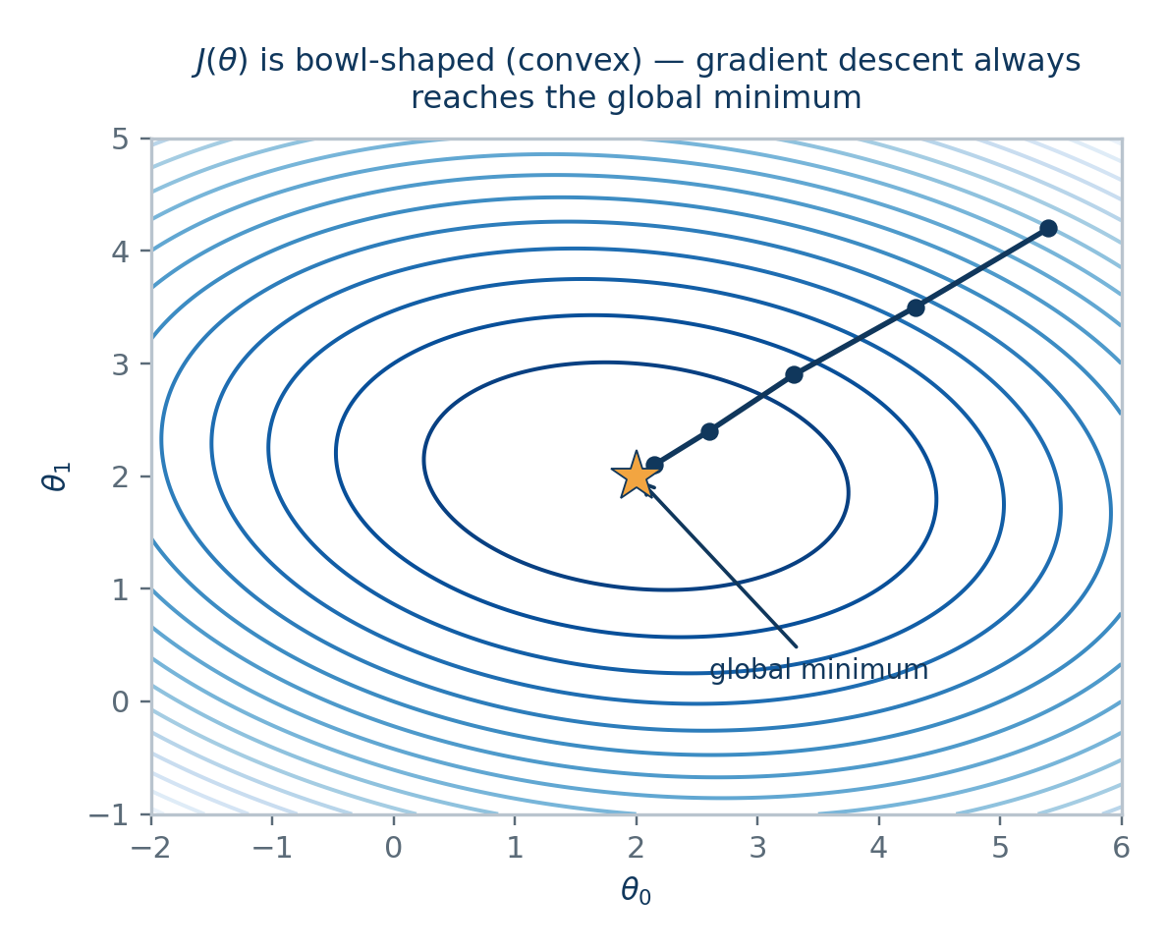
1.5 LOSS FUNCTION
The Mean Squared Error Cost Function
The factor 1/2 is a convention that cancels neatly when we differentiate (it doesn't change the minimizer θ).
1/m averages the error over all m training examples, so cost is comparable across dataset sizes.
Squaring penalizes larger errors disproportionately and keeps the function differentiable everywhere.
J(θ) is a convex quadratic bowl in θ — it has exactly one global minimum, no local minima to get stuck in.
Linear & Logistic Regression
6

Slide 9
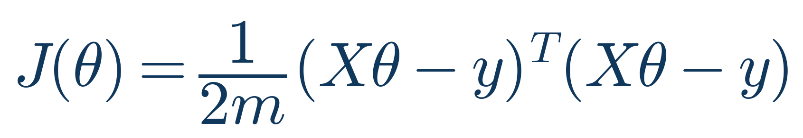
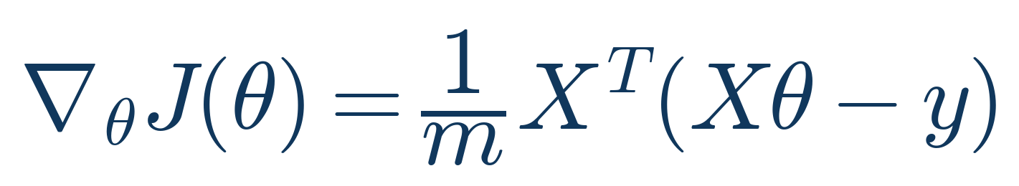
1.6 VECTORIZED DERIVATION
Cost & Gradient in Matrix Form
Stacking all m examples into a design matrix X ∈ ℝ^(m×(n+1)) and targets y ∈ ℝᵐ, the cost becomes:
Differentiating with respect to the vector θ (using matrix calculus) gives the gradient:
Derivation sketch
• Expand (Xθ − y)ᵀ(Xθ − y) = θᵀXᵀXθ − 2θᵀXᵀy + yᵀy
• Use the matrix-calculus identities ∂(θᵀAθ)/∂θ = 2Aθ (for symmetric A) and ∂(bᵀθ)/∂θ = b
• ∇_θ J(θ) = (1/m)[XᵀXθ − Xᵀy] = (1/m) Xᵀ(Xθ − y)
• This single vectorized expression drives BOTH the normal equation and gradient descent below.
Linear & Logistic Regression
7

Slide 10

1.7 CLOSED-FORM SOLUTION
The Normal Equation
Setting the gradient from the previous slide to zero and solving for θ directly:
Normal Equation vs Gradient Descent
✓ No learning rate α to tune
This gives the exact optimum in one step — no iterations, no learning rate.
→ Requires choosing α
Complexity: O(n³) to invert XᵀX (n = number of features)
✓ No iteration needed
→ Needs many iterations
Best when: n is small–moderate (roughly n < 10,000)
✓ Slow / infeasible for large n
Feature scaling: Not required (unlike gradient descent)
→ Scales well to large n
Watch out for: XᵀX must be invertible — fails with redundant / perfectly correlated features (use Ridge, next section, to fix this)
✓ Exact solution
→ Approximate, converges to optimum
Linear & Logistic Regression
8

Slide 11
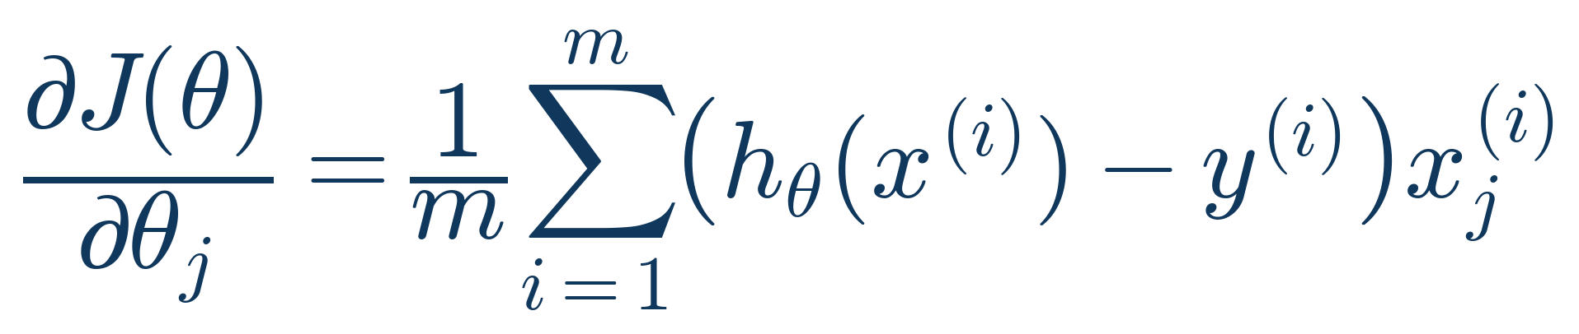

1.8 ITERATIVE OPTIMIZATION
Gradient Descent — Update Rule
Taking the partial derivative of J(θ) with respect to a single parameter θⱼ:
Gradient descent repeatedly moves θⱼ a small step opposite to the gradient (the direction of steepest ascent):
α — the learning rate
Simultaneous update
Controls step size. Too small → slow convergence. Too large → overshoot or diverge. See the learning-rate chart in section 1.12.
All θⱼ must be updated together using the OLD θ values — not sequentially — otherwise later partial derivatives use already-updated parameters and the math breaks.
Linear & Logistic Regression
9

Slide 12
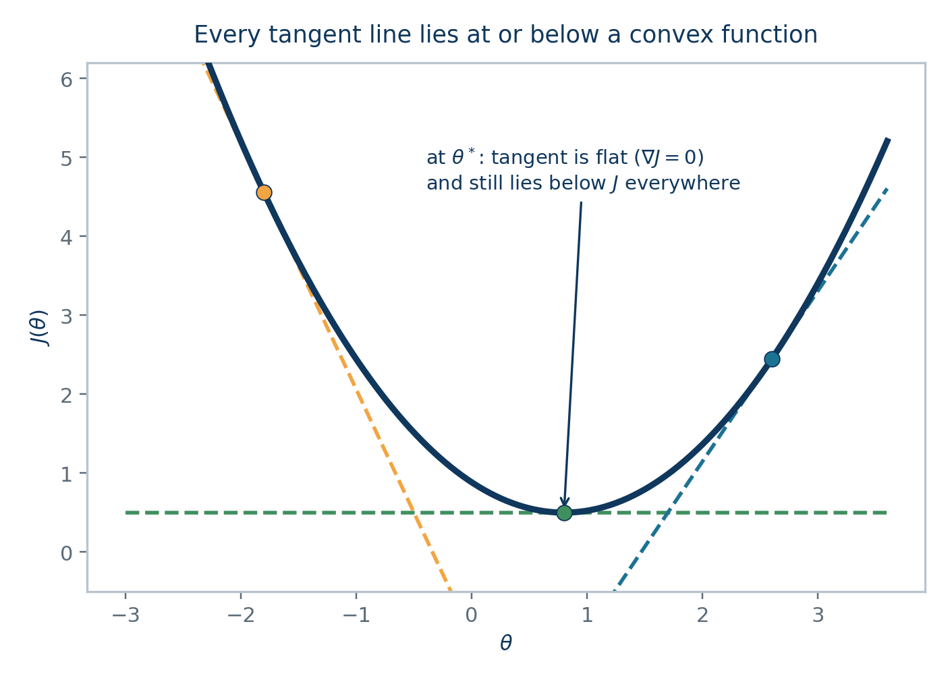

1.9 CONVERGENCE THEORY — PART I
Why a Stationary Point Is THE Global Minimum
A convex function always lies ON OR ABOVE every one of its own tangent lines:
This single geometric fact is what makes convex optimization tractable. Setting the tangent's slope to zero at some point θ* gives:
Why this matters
For a NON-convex loss (e.g. a neural network's), a point where the gradient is zero could be a local minimum, saddle point, or plateau — nowhere near the best solution. For our convex MSE and cross-entropy costs, there's no such ambiguity: every stationary point is automatically the single best point in the entire parameter space.
Linear & Logistic Regression
10

Slide 13
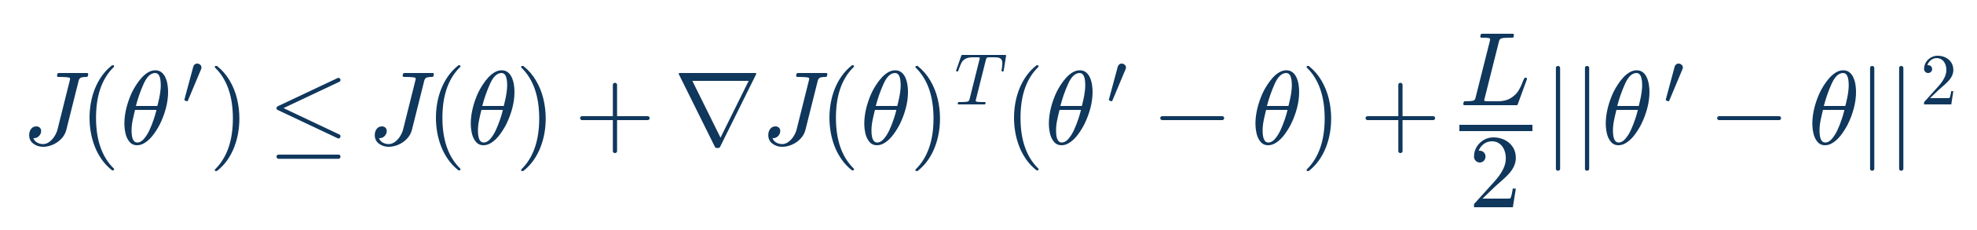

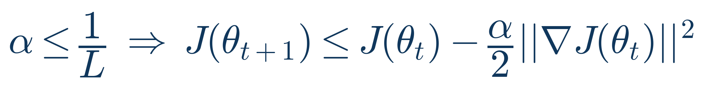
1.10 CONVERGENCE THEORY — PART II
The Descent Lemma: Every Step Decreases the Cost
Assume ∇J doesn't change arbitrarily fast — formally, ∇J is L-Lipschitz. This gives a quadratic UPPER BOUND on J anywhere:
Plugging in the gradient-descent step θ' = θ − α∇J(θ) and simplifying gives the DESCENT LEMMA:
Choosing a safe step size
A concrete guarantee
The term (1 − Lα/2) is positive whenever α < 2/L. In that regime, the RHS above is strictly less than J(θ) — every single step is guaranteed to make progress, never overshoot into a worse region.
Taking α ≤ 1/L (a common, conservative choice) simplifies this to a clean per-step decrease proportional to the squared gradient norm:
Linear & Logistic Regression
11

Slide 14

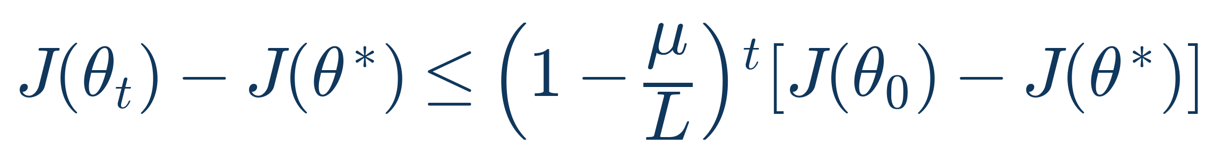
1.11 CONVERGENCE THEORY — PART III
Putting It Together: Convergence to θ*
Summing the per-step decrease from the previous slide over T iterations telescopes — most terms cancel, leaving only the start and end cost:
Since the left side is a sum of non-negative terms bounded above by a FINITE number, the individual terms must shrink to zero. Combined with the convexity argument from two slides ago:
Convergence rate
Connecting theory to our cost function
For linear regression's MSE, L is exactly the largest eigenvalue of (1/m)XᵀX — feature scaling shrinks L, which is why standardizing lets you use a bigger, faster learning rate.
Linear & Logistic Regression
12

Slide 15
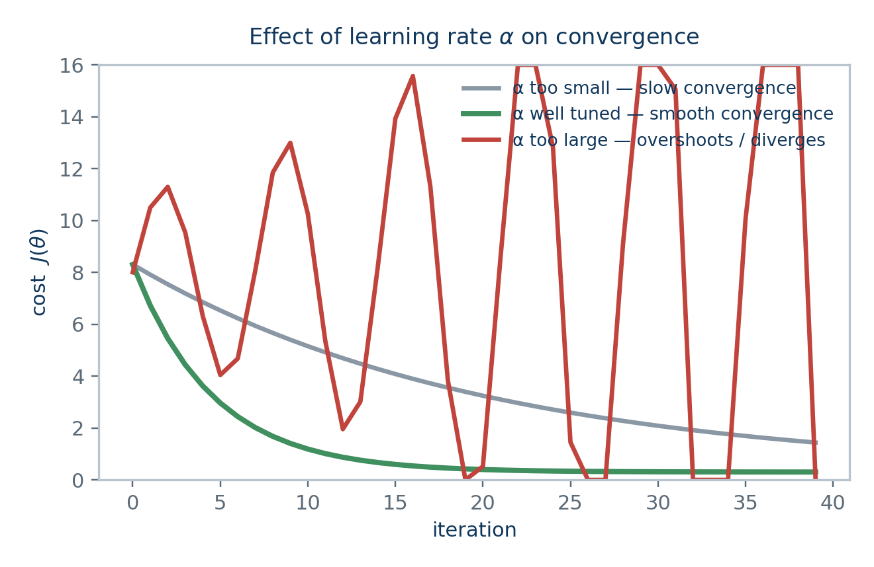
1.12 PRACTICAL OPTIMIZATION
Gradient Descent Variants & Learning Rate
Batch GD
Stochastic GD
Mini-batch GD
Uses ALL m examples per update step.
Uses ONE random example per update.
Uses a small batch (e.g. 32–256).
Stable, accurate gradient — but slow per step on large datasets.
Very fast updates, noisy path, needs a decaying α to converge.
The standard in practice — balances speed and stability.
Choosing a learning rate
• Start with values like 0.3, 0.1, 0.03, 0.01 … and observe J(θ) vs iteration.
• J(θ) should decrease every iteration for batch GD — if it increases, α is too large.
• Use a learning-rate schedule (decay α over time) for SGD / mini-batch to settle near the true minimum.
• Adaptive optimizers (Adam, RMSProp, Adagrad) automate this — covered in the CNN/RNN weeks.
Linear & Logistic Regression
13

Slide 16
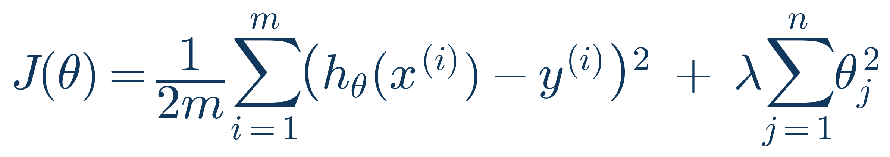
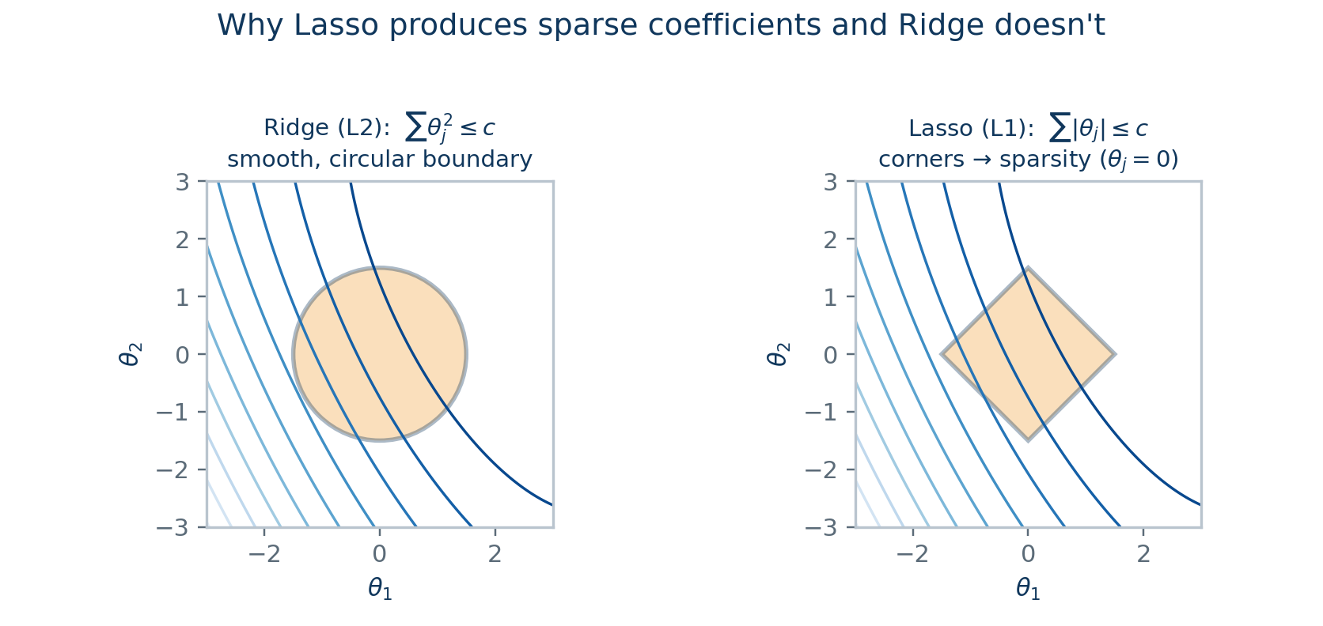

1.13 REGULARIZATION
Ridge Regression (L2 Penalty)
Ridge adds a penalty on the squared magnitude of the weights to the cost function:
This has a modified closed-form solution:
(I' is the identity matrix with a 0 in the top-left, since we typically don't regularize the bias θ₀)
λ (lambda) controls regularization strength: λ = 0 recovers ordinary least squares; large λ shrinks all θⱼ toward zero.
Shrinking weights reduces variance (overfitting) at the cost of a little bias — the classic bias-variance trade-off.
Adding λI always makes XᵀX + λI invertible — Ridge also fixes multicollinearity issues from the normal equation.
Preview: constraint regions for Ridge vs Lasso (next slide)
Linear & Logistic Regression
14

Slide 17
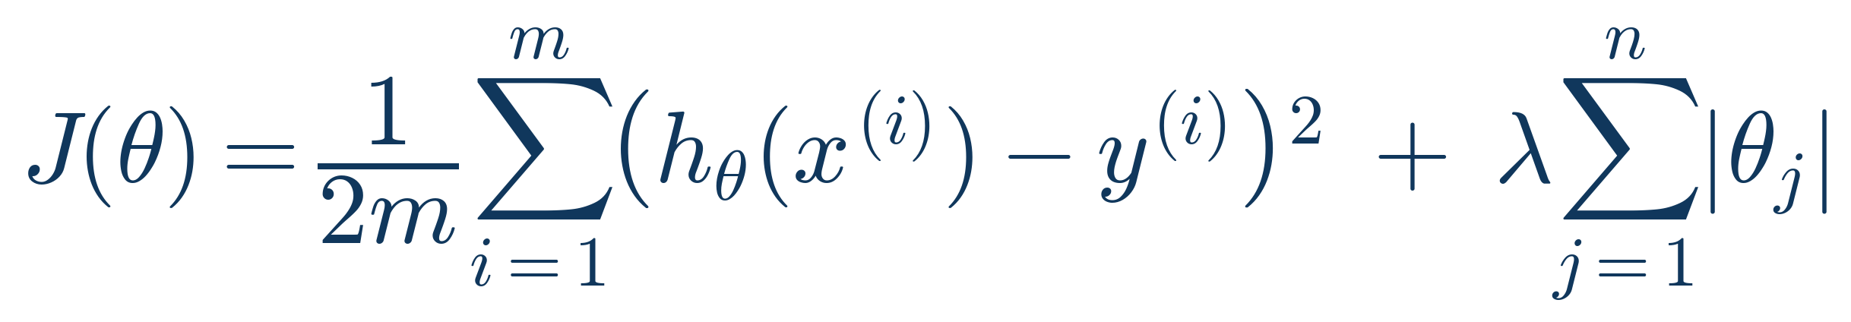
1.14 REGULARIZATION, CONTINUED
Lasso (L1) & Elastic Net
Lasso penalizes the absolute value of the weights instead of their square:
Ridge (L2)
Lasso (L1)
Shrinks coefficients smoothly toward zero, rarely exactly zero.
Can shrink coefficients to EXACTLY zero — performs feature selection.
Keeps all features — good when most features are somewhat useful.
Good when you suspect many features are irrelevant.
Elastic Net
Combines both penalties: λ₁Σ|θⱼ| + λ₂Σθⱼ² — gets Lasso's sparsity with Ridge's stability, especially useful when features are correlated.
Linear & Logistic Regression
15

Slide 18
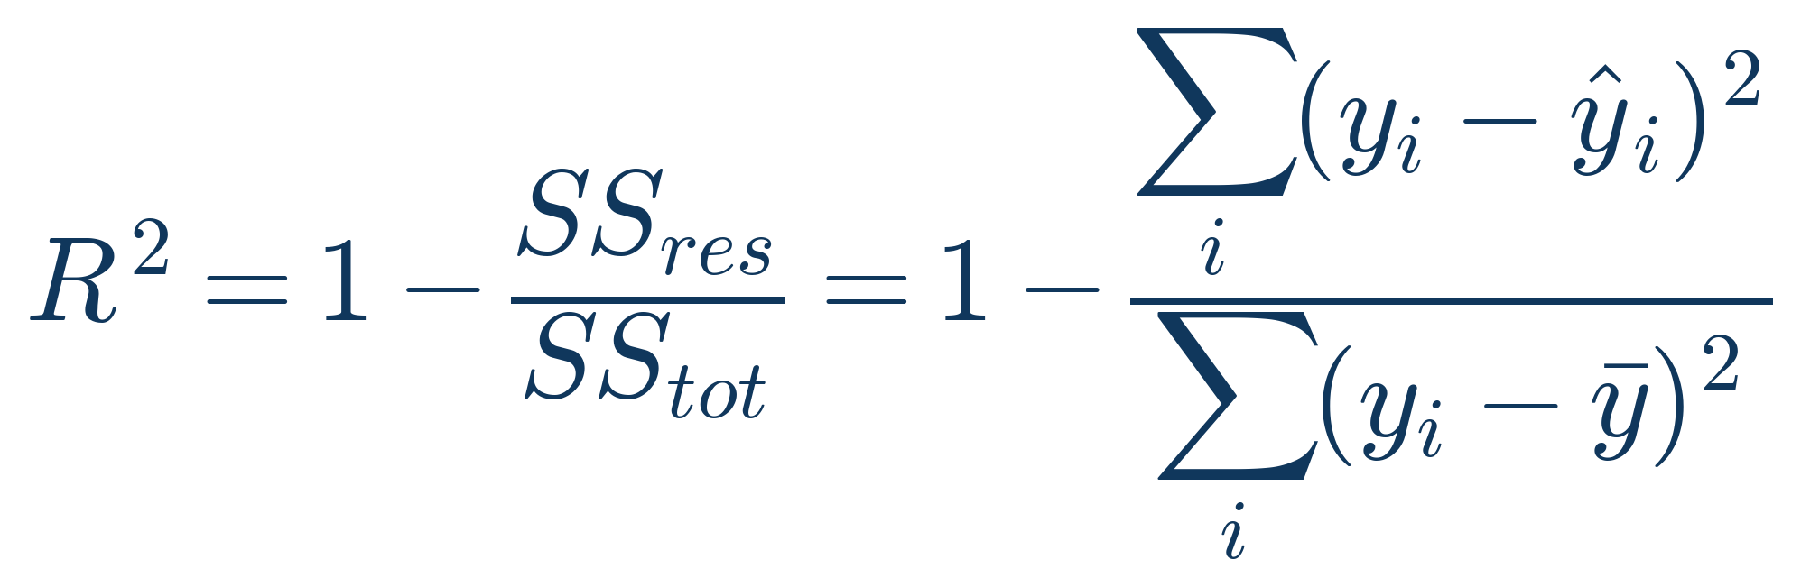
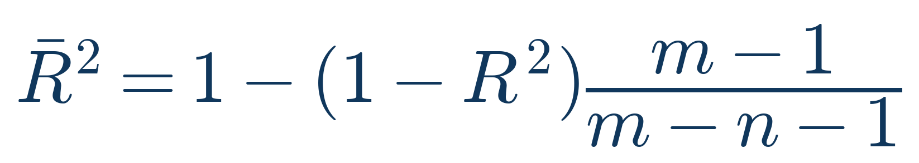
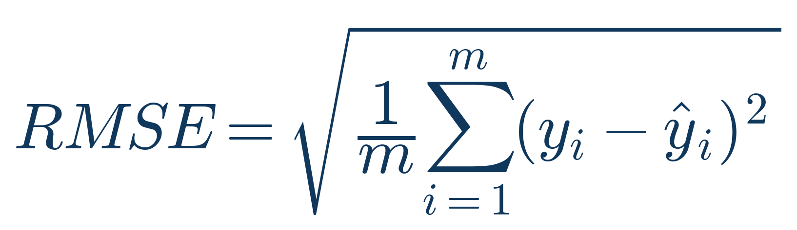
1.15 EVALUATION
Evaluating a Regression Model
R² — Coefficient of Determination
Adjusted R² — penalizes extra features
RMSE — Root Mean Squared Error
MAE — Mean Absolute Error
MAE = (1/m) Σ |yᵢ − ŷᵢ|
Same units as y; more robust to outliers than RMSE since errors aren't squared.
Reading these numbers
R² close to 1 = model explains most variance in y. RMSE penalizes large errors more (sensitive to outliers); MAE treats all errors linearly. Always compare RMSE/MAE against the natural scale of y — an RMSE of 5 means little without context.
Linear & Logistic Regression
16

Slide 19
PART 2
Logistic Regression
Predicting categories — reusing the linear model's structure inside a
probabilistic classification framework.

Slide 20
2.1 MOTIVATION
Why Not Just Use Linear Regression?
✕
Unbounded output
θᵀx ranges over all real numbers, but we need a probability strictly between 0 and 1.
✕
Sensitive to outliers
A single far-away point can shift the decision threshold for every other point.
✕
Poor loss geometry
Squared error against 0/1 labels is non-convex when composed with a hard threshold, and doesn't penalize confident wrong answers strongly enough.
✕
No probabilistic interpretation
We want p(y=1|x), not just a raw number — this requires a link function.
The fix: pass θᵀx through a squashing function that maps ℝ → (0, 1) — the sigmoid.
Linear & Logistic Regression
17

Slide 21

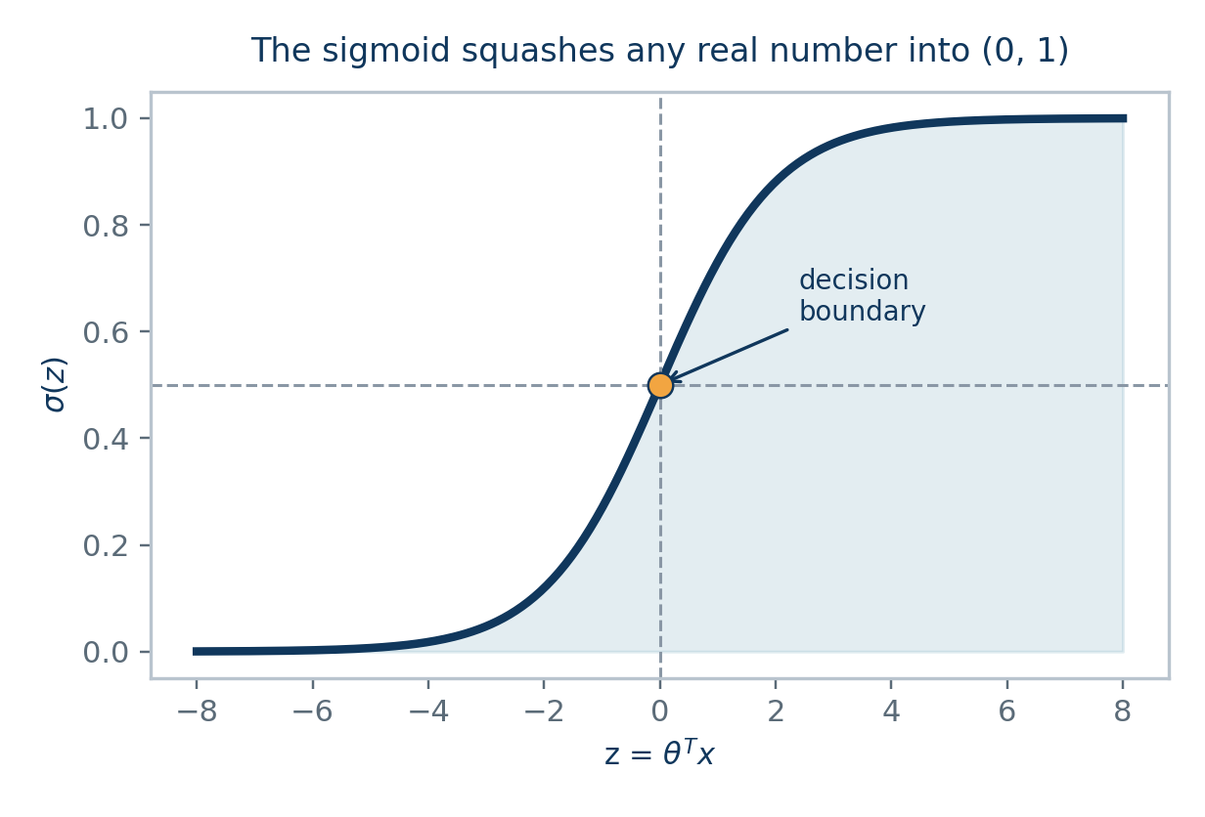
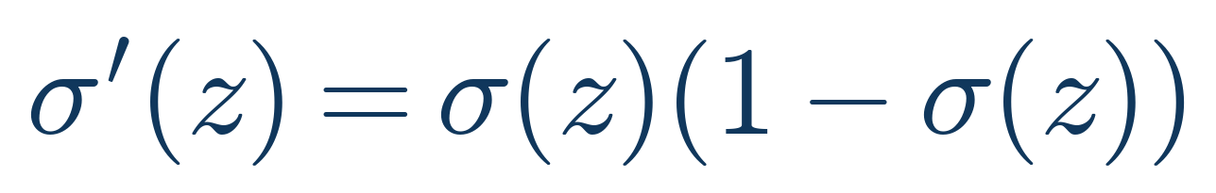
2.2 THE LINK FUNCTION
The Sigmoid (Logistic) Function
σ(z) → 1 as z → +∞, and σ(z) → 0 as z → −∞ — always bounded in (0, 1).
σ(0) = 0.5 exactly — this is the natural decision boundary.
It's smooth and differentiable everywhere, needed for gradient-based optimization.
Its derivative has a beautifully simple form (used heavily in the gradient derivation later):
Linear & Logistic Regression
18

Slide 22
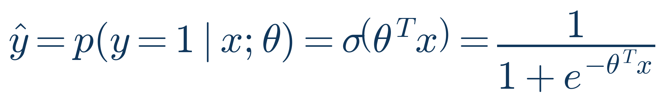

2.3 MODEL REPRESENTATION
The Logistic Regression Model & Log-Odds
The model predicts the probability that y = 1, given x:
Equivalently, the log-odds (logit) of the outcome is LINEAR in the parameters:
odds = p / (1 − p)
e.g. p = 0.8 → odds = 4 → 'four times as likely to be 1 as 0'
Why this matters
Logistic regression is a Generalized Linear Model (GLM): it keeps the familiar θᵀx linear core from linear regression, but wraps it with the logit link function. Each θⱼ has a direct interpretation — a one-unit increase in xⱼ changes the log-odds by θⱼ, i.e. multiplies the odds by e^θⱼ.
Linear & Logistic Regression
19

Slide 23
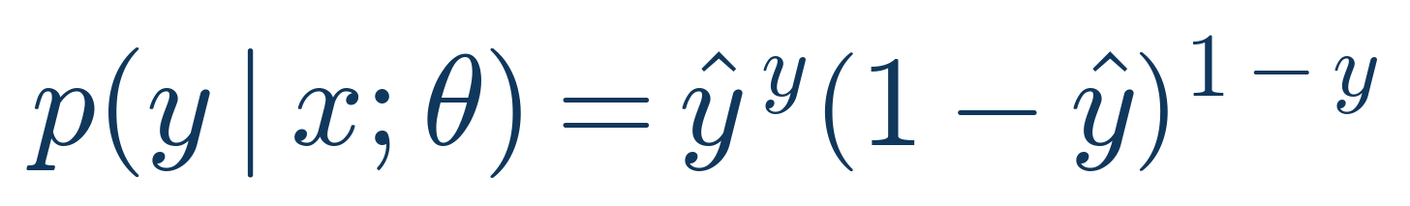
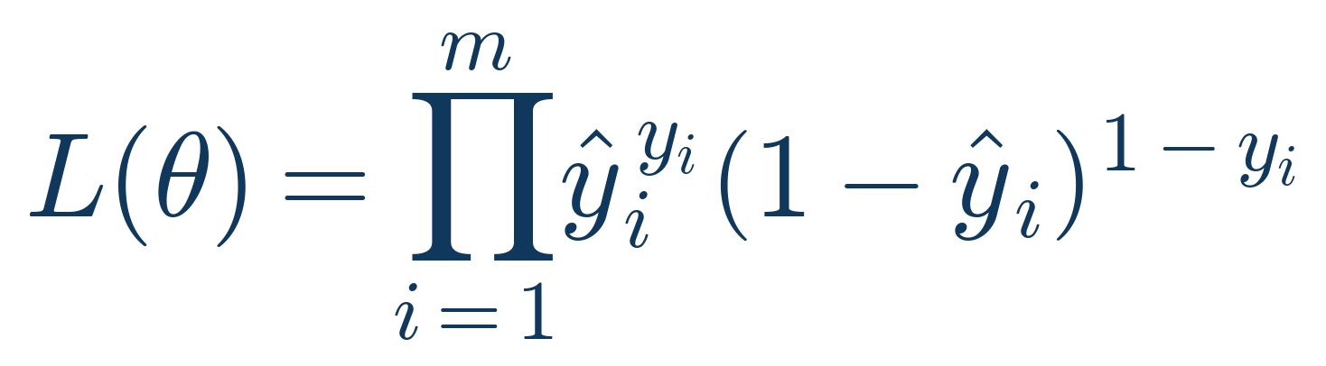
2.4 DERIVATION — PART I
Maximum Likelihood: The Bernoulli Model
Each label y ∈ {0, 1} is modeled as a Bernoulli trial with success probability ŷ:
A neat trick: this single expression equals ŷ when y=1, and (1−ŷ) when y=0 — try substituting both values.
Assuming the m training examples are independent, the full-dataset likelihood is their product:
Goal
Find θ that maximizes L(θ) — the parameters that make the observed labels most probable under our model. As with linear regression, we'll take the log first to turn the product into a sum.
Linear & Logistic Regression
20

Slide 24
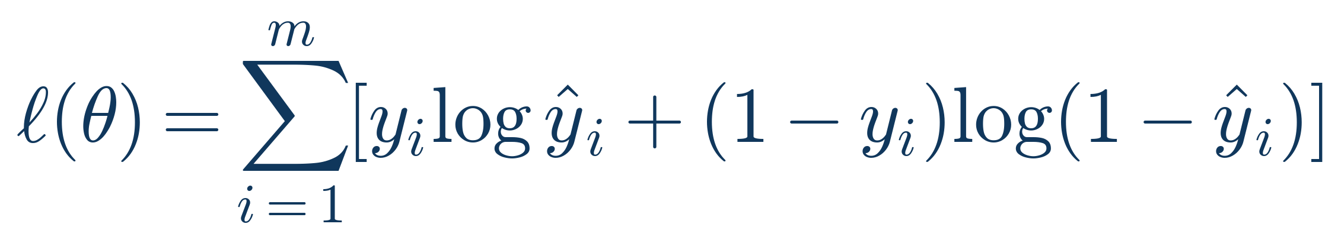

2.5 DERIVATION — PART II
Log-Likelihood → Binary Cross-Entropy Loss
Step 1 — Take the log of the likelihood (product → sum):
Step 2 — Maximizing log-likelihood ⇔ minimizing its negative average → the cross-entropy cost:
This is also called “log loss”
It's the negative average log-likelihood — minimizing it is mathematically identical to maximum likelihood estimation. Unlike squared error, cross-entropy is convex in θ (see slide 27), so gradient descent is guaranteed to find the global minimum.
Linear & Logistic Regression
21

Slide 25
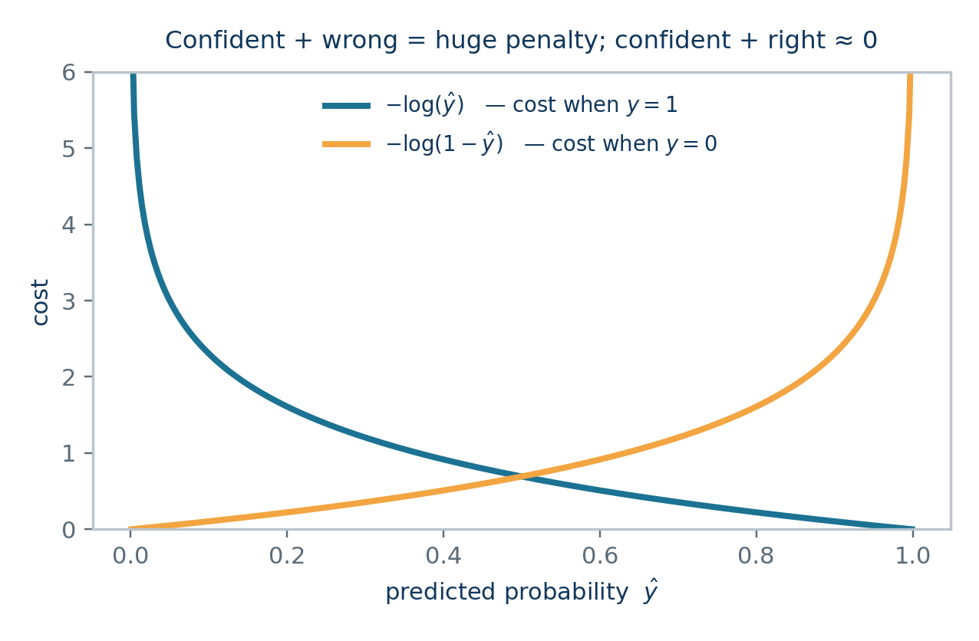
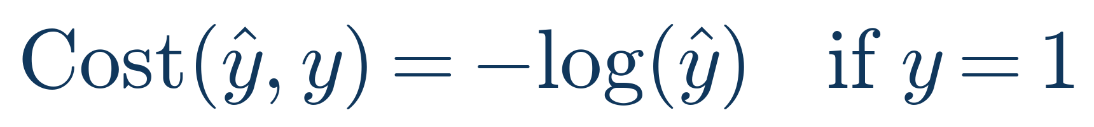
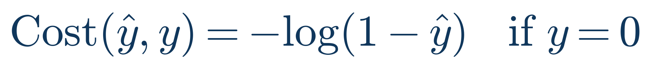
2.6 INTUITION
Why Cross-Entropy Makes Sense
For a single example, the cost splits into two cases depending on the true label y:
When y = 1: cost → 0 as ŷ → 1 (confident & correct), but cost → ∞ as ŷ → 0 (confident & wrong).
When y = 0: the mirror image — being confidently wrong is punished severely.
This asymmetric, unbounded penalty is exactly what drives the model to push predictions toward the correct extreme.
Linear & Logistic Regression
22

Slide 26
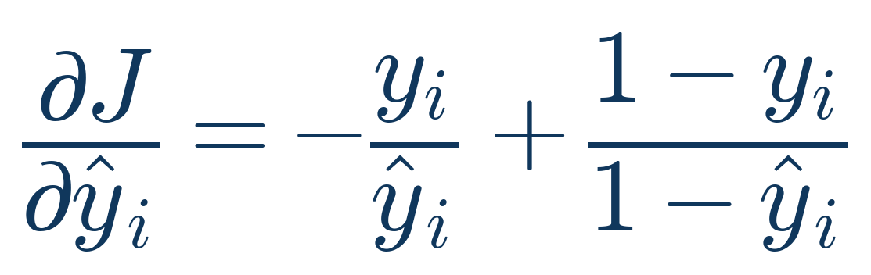
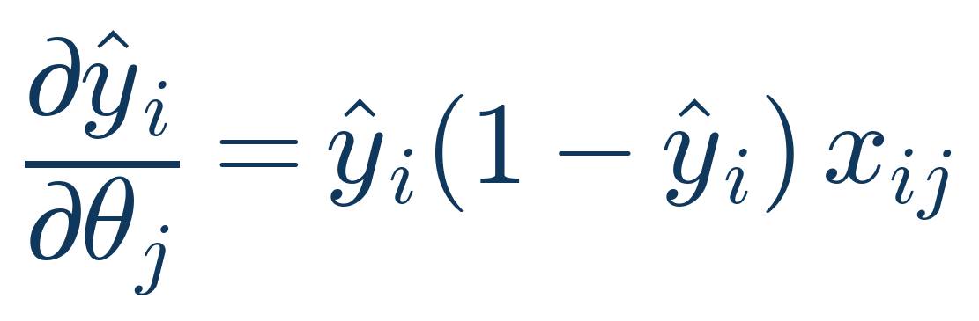

2.7 DERIVATION — PART III
The Gradient — A Beautifully Simple Result
We need ∂J/∂θⱼ. Since J depends on θⱼ only through ŷᵢ = σ(θᵀxᵢ), apply the chain rule:
∂J/∂ŷᵢ
∂ŷᵢ/∂θⱼ (using σ'(z) = σ(z)(1−σ(z)))
Multiplying the two and summing over all examples, nearly everything cancels:
Remarkable fact
This is EXACTLY the same formula as the linear regression gradient from Slide 11 — just with ŷᵢ now coming from the sigmoid instead of a raw linear output. This elegant symmetry is a general property of Generalized Linear Models with a 'canonical link' function, and it's why logistic regression's gradient descent code looks almost identical to linear regression's.
Linear & Logistic Regression
23

Slide 27

2.8 OPTIMIZATION
Gradient Descent & the Convexity Guarantee
The update rule mirrors linear regression exactly:
Unlike squared error on a sigmoid (which is non-convex), cross-entropy's Hessian is positive semi-definite:
Because this Hessian is positive semi-definite everywhere, the exact same descent-lemma argument from Slides 12–14 applies: gradient descent's steps shrink monotonically and θ_t converges to the unique global minimum.
Newton's Method / IRLS
Uses the Hessian for a curvature-aware step — converges in far fewer iterations than plain gradient descent, at higher cost per step.
L-BFGS / Conjugate Gradient
Quasi-Newton methods commonly used by sklearn's LogisticRegression solvers for fast, robust convergence.
Linear & Logistic Regression
24

Slide 28
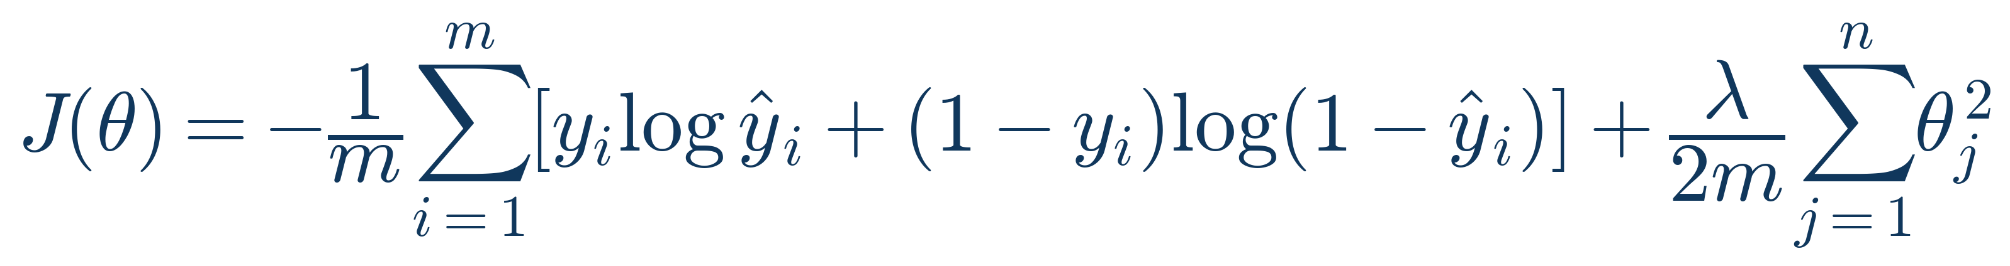
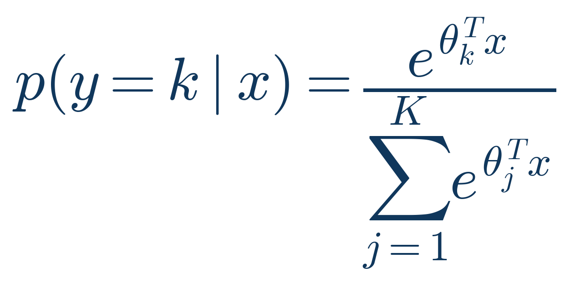

2.9 EXTENSIONS
Regularized & Multiclass Logistic Regression
L2-Regularized Cost (Ridge-style penalty prevents overfitting, exactly as before):
Multiclass — Softmax Regression (K classes):
Categorical Cross-Entropy Loss
Softmax normalizes K linear scores into a probability distribution that sums to 1. Setting K=2 and simplifying recovers the binary sigmoid exactly — logistic regression is the special case of softmax regression with two classes.
Linear & Logistic Regression
25

Slide 29
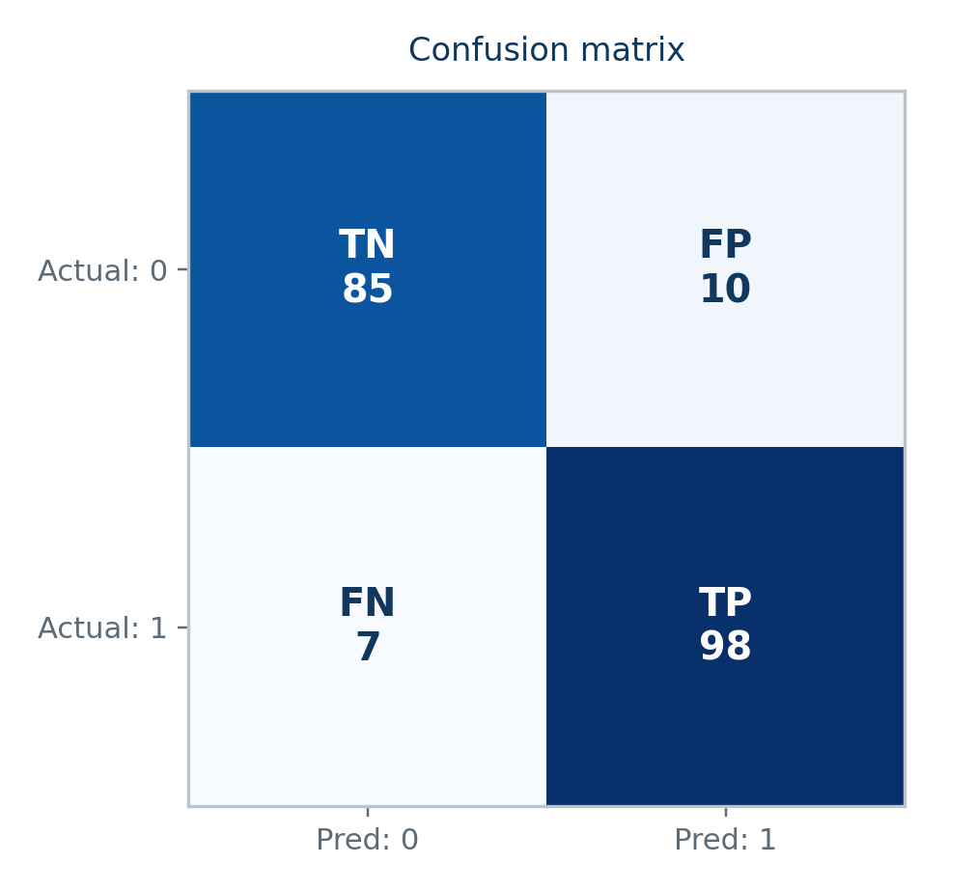
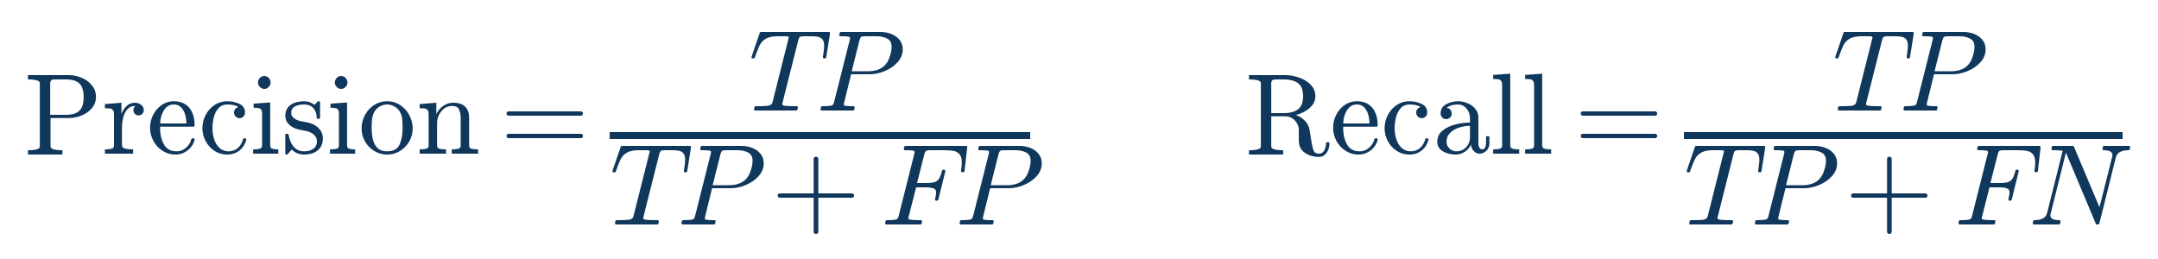

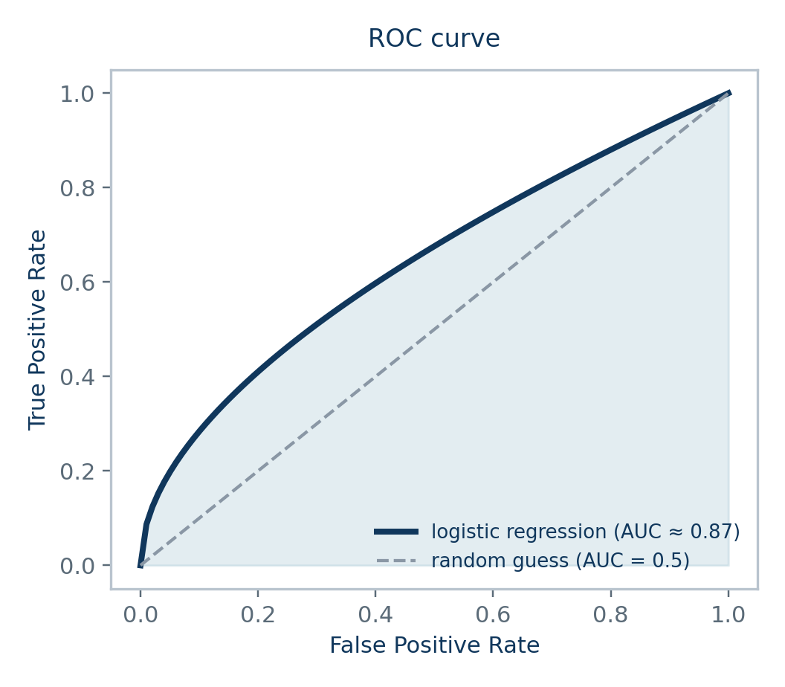
2.10 EVALUATION
Evaluating a Classification Model
Accuracy: (TP+TN) / total — misleading on imbalanced data (e.g. 95% 'healthy' baseline).
Precision: Of predicted positives, how many were correct — matters when false positives are costly.
Recall: Of actual positives, how many were caught — matters when false negatives are costly.
ROC-AUC — threshold-independent measure of separability
Linear & Logistic Regression
26

Slide 30
SYNTHESIS
Linear vs. Logistic Regression — Side by Side
Linear Regression
Logistic Regression
Task
Regression (continuous y)
Classification (categorical y)
Output
h_θ(x) = θᵀx ∈ ℝ
σ(θᵀx) = p(y=1|x) ∈ (0,1)
Link function
Identity
Sigmoid / Logit
Loss function
Mean Squared Error
Binary Cross-Entropy
Derived from
Gaussian likelihood (MLE)
Bernoulli likelihood (MLE)
Closed form?
Yes — Normal Equation
No — needs iterative optimization
Gradient formula
(1/m)Xᵀ(Xθ − y)
(1/m)Xᵀ(ŷ − y) — same shape!
Regularization
Ridge / Lasso / Elastic Net
L2 / L1 penalty on log-loss
Key metric
R², RMSE, MAE
Accuracy, F1, ROC-AUC
Linear & Logistic Regression
27

Slide 31
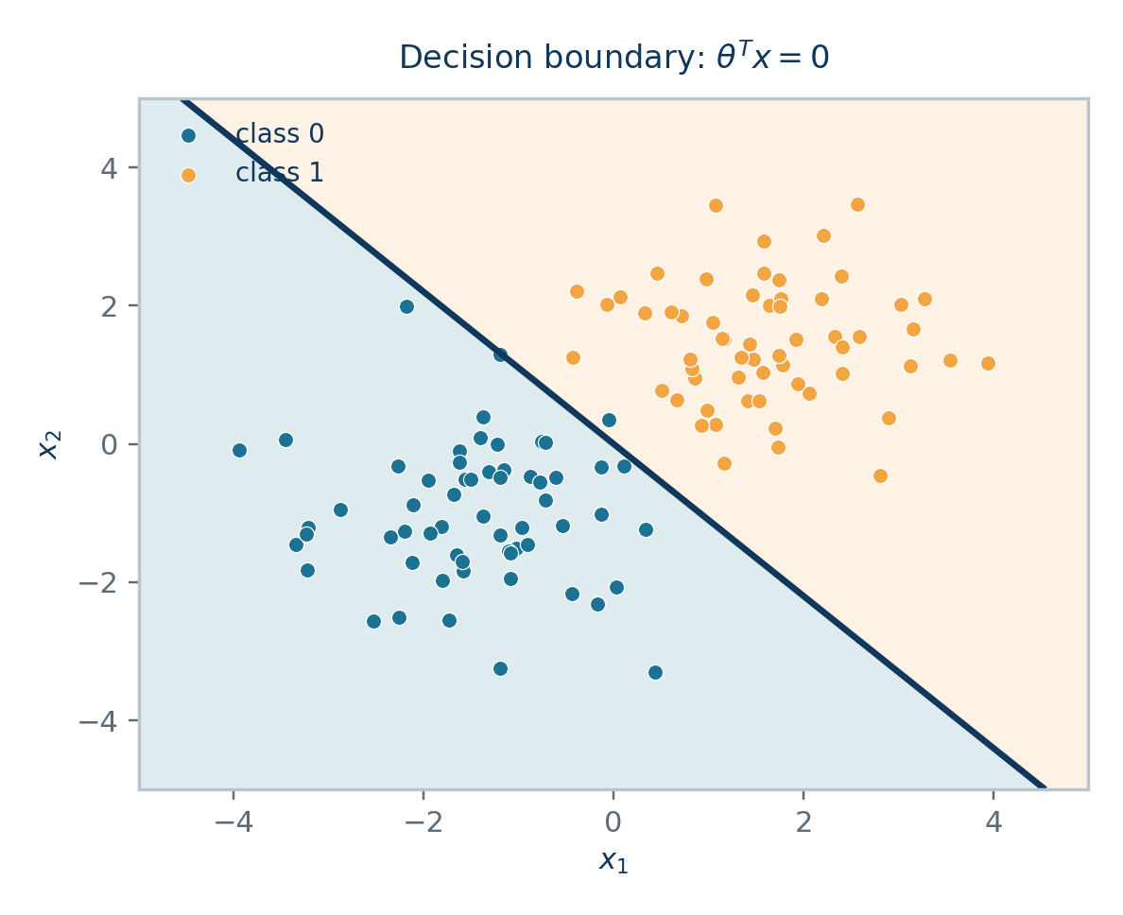
HANDS-ON
Week 5 Project: Putting Theory Into Practice
🏠 House Price Predictor
Apply LINEAR REGRESSION to the Boston Housing / Mall Customers-style dataset:
• Engineer & scale numeric features
• Fit via Normal Equation AND Gradient Descent — compare
• Evaluate with R², RMSE, MAE
• Try Ridge/Lasso if features are correlated
🌸 Iris / Customer Classification
Apply LOGISTIC REGRESSION for classification:
• Binary or multiclass (softmax) classification
• Plot the sigmoid-derived decision boundary
• Evaluate with confusion matrix, precision/recall, F1, ROC-AUC
• Regularize to avoid overfitting on small datasets
Full runnable code for both projects is in the companion Jupyter notebook →
Linear & Logistic Regression
28

Slide 32
SUMMARY
Key Takeaways
1
Both models are Generalized Linear Models: a linear core θᵀx, wrapped by a link function (identity or sigmoid).
2
Their loss functions are not arbitrary — MSE and Cross-Entropy both fall directly out of Maximum Likelihood Estimation under Gaussian and Bernoulli noise assumptions, respectively.
3
Both gradients reduce to the same elegant form: (1/m)Xᵀ(prediction − label) — which is why gradient descent code is nearly identical for both.
4
Linear regression has a closed-form solution (Normal Equation); logistic regression needs iterative optimization because there's no closed form for its likelihood equations.
5
Regularization (Ridge / Lasso / Elastic Net) extends naturally to both models to control overfitting.
6
Always match your evaluation metric to the problem: R²/RMSE/MAE for regression; Precision/Recall/F1/ROC-AUC for classification, especially under class imbalance.
Linear & Logistic Regression — Summary
29

Slide 33
Thank You
Questions? Let's dig into the math, the code, or the project together.
📊
📓
📄
Slide Deck
Jupyter Notebook
Study Guide
Theory & derivations (this file)
From-scratch + sklearn implementations
Full written derivations & reference

